Slide 1
Software Systems Design and Integration
Week 5 Lecture:
Concurrency Control and Synchronisation
1-<number>

Slide 2
LECTURE PLAN
  Concurrency Control
    Lost Update
    Inconsistency Analysis
  2. Data Locking
  3. Problems with Locking
  4. Distributed Concurrency
  5. Concurrency Control in Java
1-<number>

Slide 3
Concurrency Control
Components of distributed systems use shared resources, often concurrently:
  Hardware Components
  Operating system resources
  Databases
  Files
  Temporary Data
This may cause conflicts.
To avoid conflicts, the shared resources may need to be accessed in a mutual exclusion mode.
  Concurrency Control relies on the isolation of the shared resource use
1-<number>

Slide 4
Motivation
Concurrent access & updates may lead to:
  lost updates
    Example: Cash withdrawal from ATM and concurrent cashing of a cheque (without isolation) may result in one of these updates not being reflected in the final account balance.
  inconsistent analysis
    Example: Funds transfer between accounts of a customer while calculating the sum of account balances could result (without isolation) in an incorrect final summary of account balances.
1-<number>

Slide 5
Lost Update
markAcc.
balance
Customer@ATM
Clerk@Counter
t
0
markAcc.debit(50){
75
t
1
markAcc.credit(50){
75
t
2
new=(balance – 50);
75
t
3
new=(balance + 50);
75
t
4
balance=new;
25
t
5
}
balance=new;
125
t
6
}
125
Time
Summary: Initial balance of the account is 75; Debited - 50; Credited - 50; Final balance is 125. The debit has not been accounted for.
1-<number>

Slide 6
Inconsistent Analysis
balances
Funds Transfer
Inland Revenue Report
accA
accB
sum
t
0
accA.debit(100){
sum = 100
100
0
100
t
1
new=balance-100;
sum = 100
100
0
100
t
2
balance=new;
sum +=accB.get_balance()
0
0
0
t
3
}
0
0
0
t
4
accB.credit(100){
sum = 0
0
0
0
t
5
new=balance+100;
sum = 0
0
0
0
t
6
balance=new;
sum +=accA.get_balance()
0
100
100
t
7
}
0
100
100
Time
Summary: Initial balance of account A and final balance of account B is 100; 100 units are transferred from account A to account B but none has been reported in the interval t₂-t₅. The analysis is therefore inconsistent.
1-<number>

Slide 7
LECTURE PLAN
  1. Concurrency Control
  Data Locking
    Read/write locks
    Blocking
    Two-phase locking
  3. Deadlocks and Detection
  4. Distributed Concurrency
  5. Concurrency Control in Java
1-<number>

Slide 8
Concurrency Control using Locks
Lock Manager grants locks.
  lock is a token that indicates that a process accesses a resource in a particular mode.
  Minimal lock modes: read and write.
Grant depends on compatibility of acquisition request with modes of already granted locks.
  A data item with a read lock on it can only grant other read locks.
Compatibility defined in lock compatibility matrix.
Read
Write
Current Lock
Read
✓
❒
Request
Write
❒
❒
1-<number>

Slide 9
Avoiding Lost Updates through Locking
MarkAcc.
balance
Customer@ATM
Clerk@Counter
t
0
MarkAcc.debit(50){
75
t
1
lock(write);
MarkAcc.credit(50){
75
t
2
new=balance-50;
lock(write);
75
t
3
balance=new;
WAIT FOR UNLOCKING
25
t
4
unlock(write);
25
t
5
}
new=balance+50;
25
t
6
balance=new;
75
t
7
unlock(write);
75
t
8
}
75
Time
Summary: Initial balance of the account is 75; Debited - 50; Credited - 50; Final balance is 75 which is correct due to the extra waiting. The two threads run concurrently, but the operations are in fixed order, i.e. the threads are synchronized
1-<number>

Slide 10
Two-Phased Locking (2PL)
The most popular concurrency control technique, implemented in various systems:
  Backend – RDBMS (Oracle, Ingres, Sybase, DB2) and ODBMSs (Versant, POET, O2, ObjectStore, etc.)
  Software products specifically for transaction monitoring (CICS, MTS, etc.)
  Transaction control programmed as part of the applications (i.e., JTS services in Java EE)
Granting access is done in two-phases
  Concurrent threads must acquire locks on shared resources from lock manager.
  Lock manager grants lock if request does not conflict with already granted locks.
  Threads release locks afterwards.
1-<number>

Slide 11
LECTURE PLAN
  1. Concurrency Control
  2. Data Locking
  3. Problems with Locking
      Race Conditions
      Deadlocks
  4. Distributed Concurrency
  5. Concurrency Control in Java
1-<number>

Slide 12
Problems with Locking
In some cases protecting the operations using locks within the thread is not sufficient for the overall consistency
In addition to locking the shared data the critical methods can be constrained so that they participate in only one thread at a time (blocking the thread)
Alternatively, the Lock Manager can adopt more flexible policy of granting access which accounts the type of locks requested and the type of locks currently applied (two-phase locking)
1-<number>

Slide 13
Locking Problems - Race Condition
What would happen if two threads tried to withdraw from a BankAccount at the same time?
Each thread has its own copy of local variables and parameters, but fields are shared between threads
alice
bob
BankAcct
Client
Client
balance
acct
0
acct
1000
900
950
alice’s copy of curBal: 1000
bob’s copy of curBal: 1000
public class BankAccount
{ private int balance;
…
public void withdraw( int amt )
{
int curBal = getBalance();
// possible delay
balance = curBal - amt;
}
}
public class Client
extends Thread
{ ...
public void run()
{
…
acct.withdraw( 100 );
…
}
}
public class Client
extends Thread
{ ...
public void run()
{
…
acct.withdraw( 50 );
…
}
}
balance = 1000 – 100 = 900
balance = 1000 – 50 = 950
1-<number>

Slide 14
The Problem
These happen when a thread accesses data while another thread is in-between reading and writing it
Problem: the 2nd thread gets the old data and doesn’t see the update
  in this case, bob doesn’t see the change in balance due to Alice's withdrawal
Hard to catch in real life
  the longer the delay between the read and the update, the bigger the chance of a race condition
  delays can be due to having to read/write a file, networks, etc.
1-<number>

Slide 15
The Resolution
The wrong way: controlling the durations
  make delay shorter (for example, by not using files)
  This is BAD because
    the chance of error is small, but it is still there
    it could fail when somebody’s life depended on it
    (or, hackers can find the flaw and steal your money)
The right way: controlling the access
  don’t allow a 2nd thread to use the bank account while the 1st one is using it
  This can be done automatically or programmatically (in Java through the use of the keyword synchronized)
1-<number>

Slide 16
Banking Example Revisited
Each thread has its own copy of local variables and parameters, but fields are shared between threads
Now the method withdraw is synchronized, so only one thread can enter it at a time
Alice got here first … I have to wait
alice
bob
BankAcct
Client
Client
balance
acct
0
acct
1000
900
850
alice’s copy of curBal: 1000
bob’s copy of curBal: 900
public class BankAccount
{ private int balance;
…
public synchronized
void withdraw( int amt )
{
int curBal = getBalance();
// possible delay
balance = curBal - amt;
}
}
public class Client
extends Thread
{ ...
public void run()
{
…
acct.withdraw( 100 );
…
}
}
public class Client
extends Thread
{ ...
public void run()
{
…
acct.withdraw( 50 );
…
}
}
balance = 1000 – 100 = 900
balance = 900 – 50 = 850
1-<number>

Slide 17
Locking Problems - Deadlocks
2PL may lead to deadlocks, i.e. processes waiting for each other to release locks.
  Deadlocks have to be detected by the lock manager.
Deadlock detection uses wait-for graphs and system timer
  Deadlock occur if wait-for graph contains cycle
Example: Process A has locked resource X but requires resource Y, Process B has locked resource Y but requires X.
A
B
X
Y
1-<number>

Slide 18
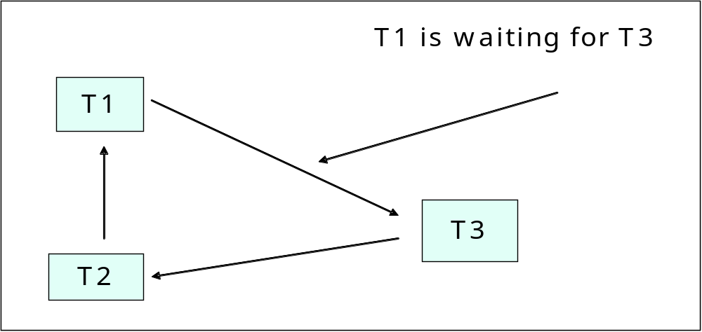
The Resolution – “Wait-For” Graph
Ensure you read pp581-589 of the textbook
on Distributed Deadlock!
1-<number>

Slide 19
LECTURE PLAN
  1 Concurrency Control
  2 Data Locking
  3 Problems with Locking
  4 Distributed Concurrency
    Methods for Concurrency Control
    Concurrency Access to Databases
    Concurrent Transactions
    Wait-for graph and distributed deadlocks
  5 Concurrency Control in Java
1-<number>

Slide 20
Distributed Concurrency
In a client/server system a number of clients will often access shared data stored on a server.
  Typically the shared data is stored in files or databases
  This requires additional concurrency control, which relies on external mechanisms – DBMS or OS
In distributed systems the data may be stored in several locations but replicated for scalability
The same data can be processed by different components remotely but in transparent manner
1-<number>

Slide 21
Distributed Concurrency – Methods for Concurrency Control
Use of the “many reader/single writer” scheme for centralized control
Apply strict two phase locking under the control of a central controller
Use “Wait-for” graphs for controlling the distributed resources (both on data and operations level)
1-<number>

Slide 22
Distributed Concurrency – Databases
Most database management systems (DBMS) allow a number of lock levels. These include:
  Row locking, where a row of DB table is locked.
  Page locking, where a page of file storage containing part of a table or table index is locked.
  Table locking, where a whole table is locked.
  Database locking, where the whole of a database (every table) is locked.
1-<number>

Slide 23
Distributed Concurrency – Transactions
In the distributed systems the transactions can be started in one place and finished in another place, which requires distributed transaction management
  When the data is distributed but the operations on the same data are performed within the same database the standard concurrency control mechanisms of DBMS can be used
  When the operations are distributed an external mechanism must be used – either OS Transaction Manager (i.e., Microsoft MTS), or programmable transaction manager (i.e., Java JTS)
1-<number>

Slide 24
LECTURE PLAN
  1 Concurrency Control
  2 Data Locking
  3 Problems with Locking
  4 Distributed Concurrency
  5 Concurrency Control in Java
    Automatic synchronization
    Event ordering by using the Thread Lifecycle Methods
    Controlling the Access to Shared Data by Locking
1-<number>

Slide 25
Concurrency Control in Programming
What is needed to control the concurrency:
    Which code execution forks threads
    Which data is shared between threads
    Which thread code requires events ordering
Three methods for synchronization of the concurrent threads
        Automatic synchronization based on the use of thread safe operations and thread safe data only (no need for additional synchronization)
        Programmatic ordering of the events through blocking the multithreading in part of the code (forcing the threads to wait)
        Programmatic data privatization through locking the shared data (queueing for data access)

Slide 26
Automatic synchronization
The thread safe methods are declared using the keyword synchronized
The Java runtime engine synchronizes the execution of the methods automatically
  Every synchronized method of an object is assigned a runtime monitor
  The monitors allow one thread only inside a synchronized method at a time
  All other threads are blocked until synchronized method finishes
  Next highest priority thread runs when synchronized method finishes

Slide 27
Atomizing the Operations
Java allows you to group operations and block the thread during their execution
  The atomized operations are declared using the keyword synchronized:
  synchronized ( <object> ) {
  statements
  } // end synchronized statement
    <object> is normally the reference this if the operation is defined in the object in which the synchronized statement appears.
  Here <object> is the object whose monitor lock will be acquired by the runtime engine automatically
When a synchronized statement finishes execution, the object’s monitor lock is released
© Copyright 1992-2012 by Pearson Education, Inc. All Rights Reserved.

Slide 28
Thread-safe Data Sharing
Primitive data types can be shared between threads without synchronization if all operations in them are thread safe – why?
  Java SE package java.util.concurrent provides a special set of collection data types which can be shared between threads with some build-in control over the individual components behaviour
Compound data such as heterogeneous collections and structured objects cannot be shared between threads without additional synchronization – why?
  In such a case the data needs to be declared using the keyword synchronized
© Copyright 1992-2012 by Pearson Education, Inc. All Rights Reserved.

Slide 29
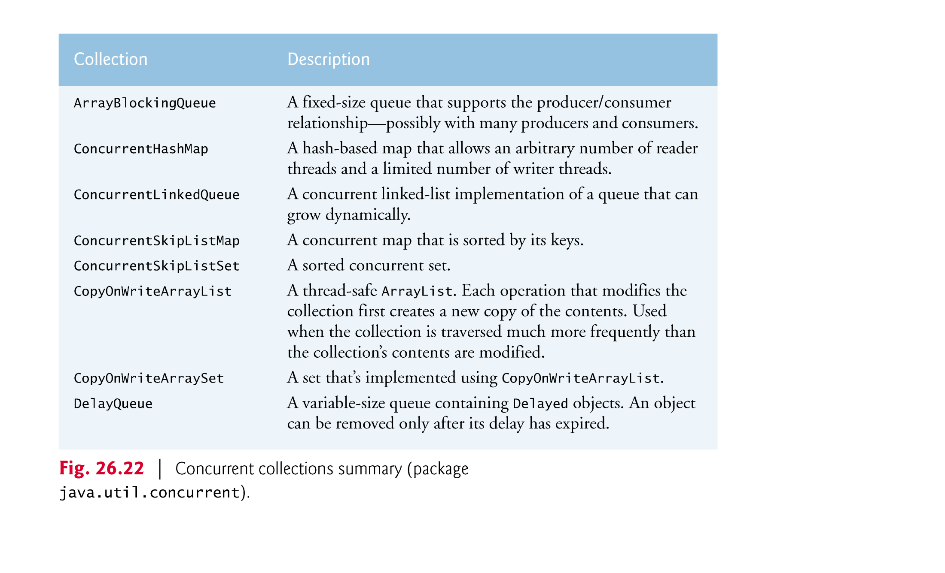
Thread Safe Collection Data Types

Slide 30
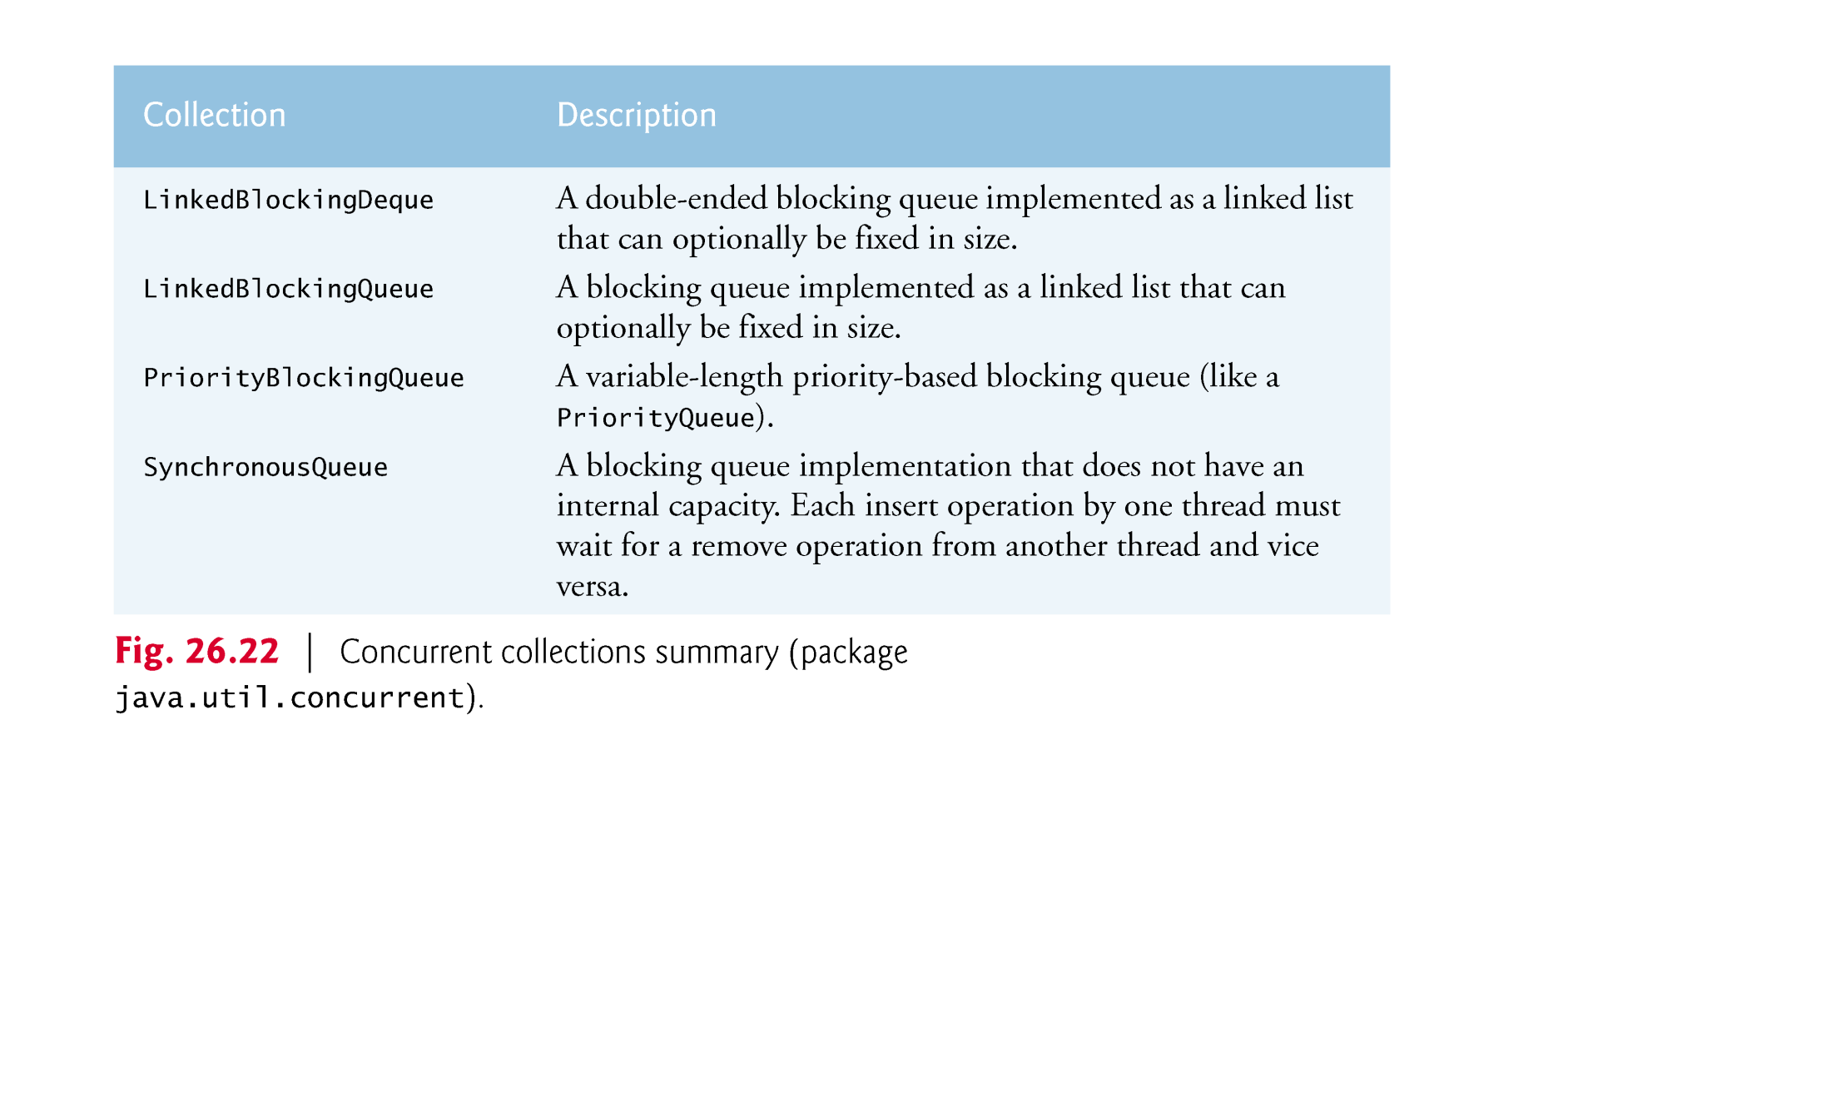

Slide 31
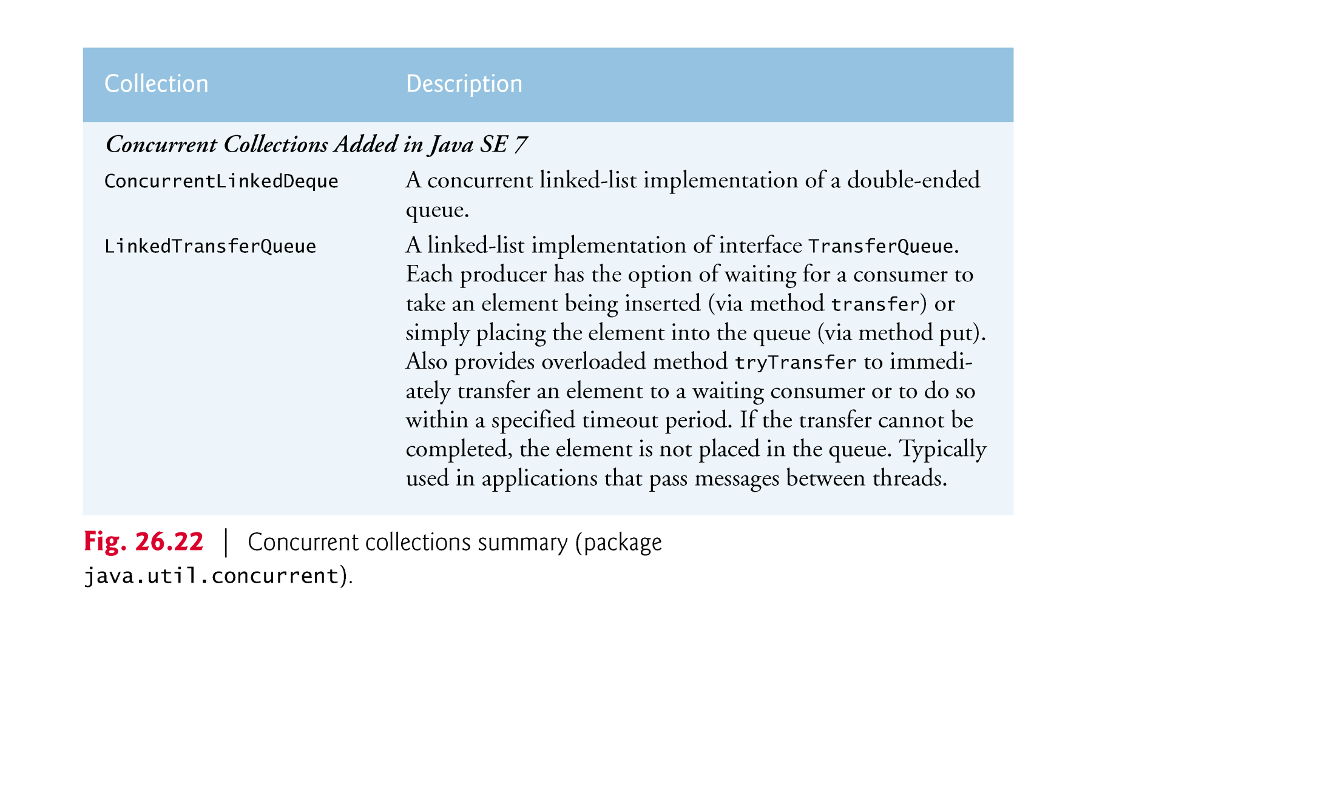
Additional thread-safe collection data types in Java SE7

Slide 32
Event ordering by using the Thread Lifecycle Methods
If some of the operations are non-thread safe, the synchronization of the threads can be achieved by calling the standard thread lifecycle methods
  Critical are those sections of the code where the threads read or write shared data; before entering the section the threads are forced to sleep
The synchronization is based on the programmatic delays caused by putting the threads into a waiting state until the critical operations execute
  After completing the execution of critical sections of the code the sleeping threads can be awaken by notifying them
© Copyright 1992-2012 by Pearson Education, Inc. All Rights Reserved.

Slide 33
Thread’s lifecycle methods for synchronization
Calling method wait() on a synchronized object releases its monitor lock, and places the calling thread in the waiting state.
Calling method notify() on a synchronized object allows a waiting thread to transfer to a runnable state again.
If a thread calls notifyAll() on the synchronized object, then all the threads waiting for the monitor lock become eligible to reacquire the lock.

Slide 34
Controlling the Access to Shared Data by Locking
Java supports data locking programmatically through the interfaces Lock and Condition (from Java SE package java.util.concurrent.locks)
The shared data must be declared using classes which implement the Lock interface
Any object can contain a reference to an instance of the Lock implementation class
The treads can call the lock() and unlock() methods of the Lock objects

Slide 35
Locking and Unlocking Shared Data
A thread can call a Lock object to acquire the lock of the object through invoking its lock() method
Once a lock has been obtained by a thread, the Lock object will not allow another thread to obtain the lock until the first thread releases it by calling the its unlock() method.
If several threads are trying to call method lock() on the same Lock object at the same time, only one of these threads can obtain the lock—all the others are placed in a queue waiting for that lock
When a thread calls method unlock(), the lock on the object is released and the waiting threads proceed in their attempt to lock the object again
© Copyright 1992-2012 by Pearson Education, Inc. All Rights Reserved.

Slide 36
Conditions for Releasing the Locks
If a thread that owns a Lock determines that it cannot continue with its task until some condition is satisfied, the thread can wait on a condition object.
  Java allows you to explicitly declare the condition objects on which a thread may need to wait. For example, in the producer/consumer example, producers can wait on one object to be produced and consumers on another to be delivered
Condition objects are associated with a specific Lock and are created by calling the Lock’s newCondition() method, which returns an object which is instance of the class that implements the Condition interface
    Not possible when the objects are declared as synchronized (they have built-in monitor lock which can be used only autiomatically).

Slide 37
Changing the Conditions
To wait for Condition on a condition object, the thread can call the Condition’s await() method.
This immediately releases the associated Lock and places the thread in the waiting state for that Condition.
When a runnable thread completes a task and determines that the waiting thread can now continue, the runnable thread can call Condition method signal() to allow a thread in that Condition’s waiting state to return to the runnable state.
If a thread calls Condition method signalAll, then all threads waiting for that condition move to runnable state and become eligible to reacquire the Lock again.

Slide 38
Comparison of different methods for synchronization
 | Operations | Data | Synchronization
Automatic | - Thread-safe operations - Synchronized methods | - Primitive data - Thread-safe collections | Automatically by thread monitors
Event ordering | - Any type of operations - Any type of methods | Primitive data Thread-safe collections | Putting the threads in waiting state Notifying the waiting threads to awake
Shared data access control | - Thread-safe operations - Synchronized methods | - Any type of data | Locking data Specifying conditions for releasing the locks

Slide 39
Additional Materials on synchronization
For information on the use of locks, visit
http://download.oracle.com/javase/6/docs/api/java/util/concurrent/package-summary.html
For information on additional concurrent collections in Java, visit
http://download.java.net/jdk7/docs/api/java/util/ concurrent/package-summary.html

Slide 40
Lecture Summary
  What we have covered in this lecture:
  Concurrency Control
  Data Locking
  Problems with Locks
  Distributed Concurrency
  Concurrency Control in Java
  What we are starting next time:
  RMI
1-<number>

